Slide 1
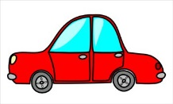
Summer Language Bingo (PreK-2)
How many “bingos” can you get this summer?
Name rhyming words: run bet | What are these? pig horse cow | Do these words rhyme? run/got bet/let | Read these words: tap bit | Tell 3 things about a
Read these words: you she | Finish the phrase: “Today I eat. Yesterday I ___.” | Name the opposites: oft over | Count the syllables in: bedtime animal | Ask a question that starts with “when”.
Ask a question that starts with “who”. | Tell 3 things about |  | Do these words rhyme? cat/mat lap/fit | Read these words: my of
Name the opposites: hot bumpy | What are these? broccoli carrot corn | Name rhyming words: cat tall | Ask a question that starts with “where”. | Tell 3 things about a
Finish the phrase: “Today I work. Yesterday I ____.” | Read these words: pet lap | Ask a question that start with “what”. | What are these? ant bee fly | What are these?

